Slide 1
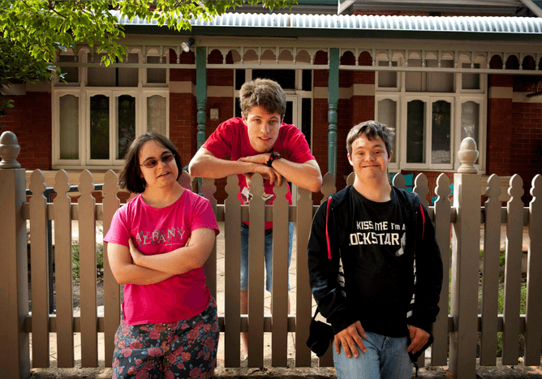
UMMC Occupational Therapy Department Virtual Simulation- Module 4
Participation for Individuals with Intellectual Disabilities
4 hours
After reviewing this module, please complete the corresponding
section in the Virtual Observation Reflection packet.

Slide 2
Review
OT’s Role in Working with People with Intellectual Disabilities
Watch: A day with an occupational therapist
Read: Supporting Community Integration and Participation for Individuals With Intellectual Disabilities

Slide 3
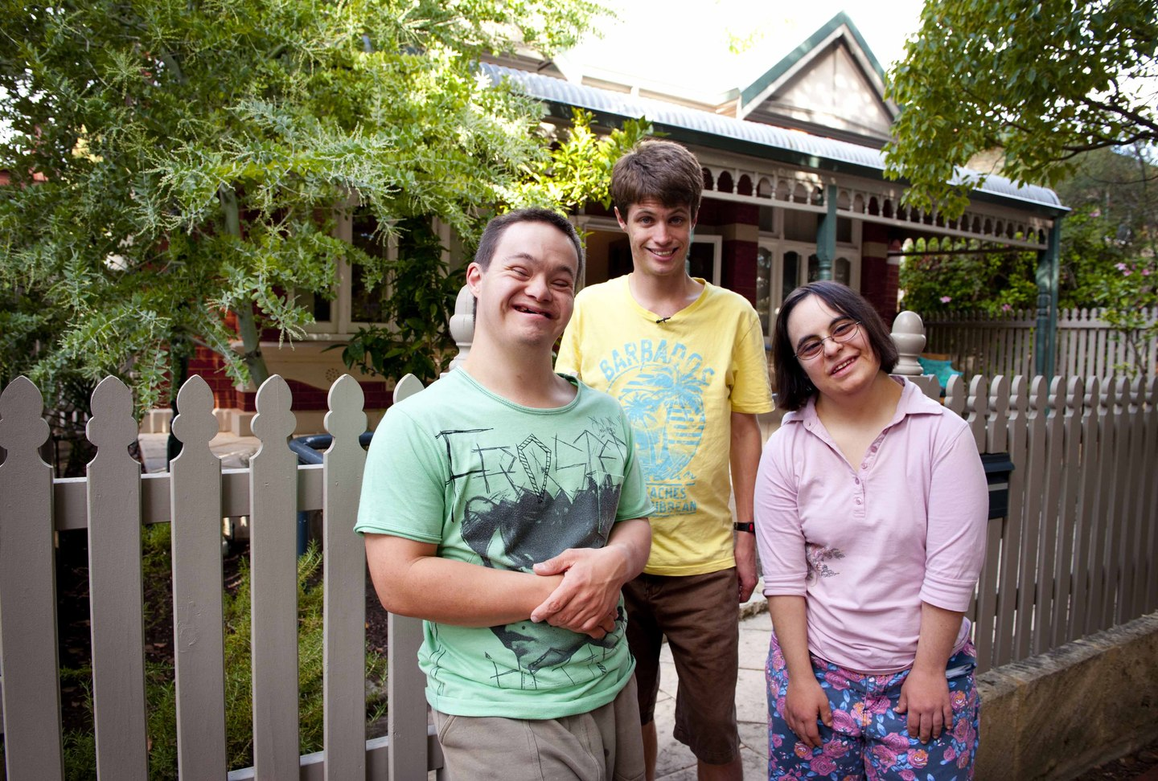
Intellectual Disability
Watch Monica & David
Monica & David is about advocating for people with disabilities to live a life they want like other people.
Answer the following questions:
How did Monica and David make you feel?
What are Monica’s and David’s goals and aspirations?
Return to Module 1 and review occupations, then answer question 4.
What occupations did each person engage in and what would they have liked to engage in?

Slide 4
References
Codina, A. (2009). Monica and david [Documentary]. HBO Films.
Leuong, E.J. (2018, August 15). A day in the life of an occupational therapist. YouTube:https://www.youtube.com/watch?v=XHCcZcuseiw
Ideishi, R., D’Amico, M., Jirikowic, T. (2013). Supporting community integration and participation for individuals with intellectual disabilities [Fact sheet]. American Occupational Therapy Association.
Monica and David https://www.youtube.com/watch?v=K2UiPIsMHFo
Pictures retrieved from google images.

